Slide 1
Notes:
Introduction

Slide 2
Notes:
Affiliation with Toxics Action Network, Hands Across the River Coalition, Coalition for Responsible siting of LNG Facilities

Slide 3
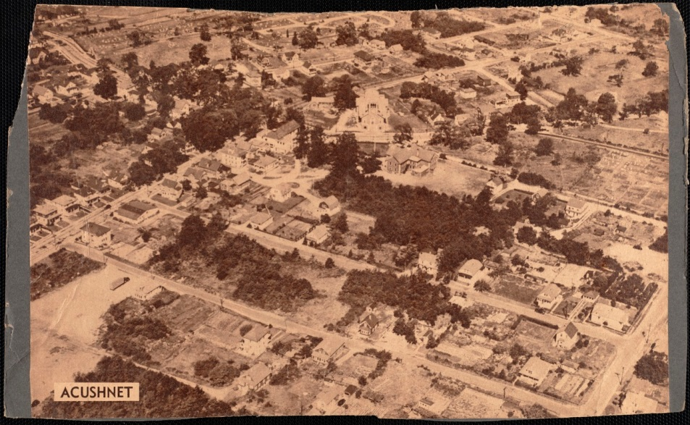
Notes:
Historical aerial picture of Acushnet – wrong place for this project

Slide 4
Notes:
Zoning/Master Plan – residentially zoned – Planning board website – “Open space is one of the defining characteristics of Acushnet. Long term preservation of these places for future generations will be a focus of the Master Plan.”

Slide 5
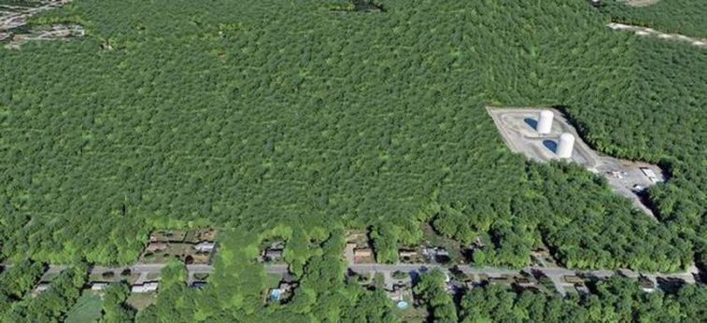
Current storage facility on Peckham Road

Slide 6
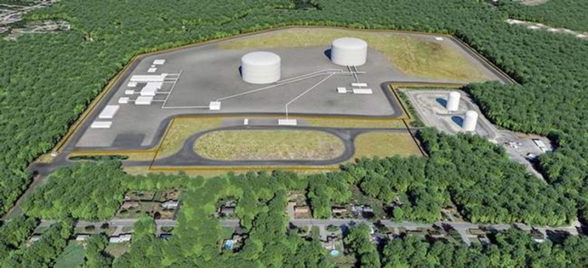
Facility with proposed changes

Slide 7
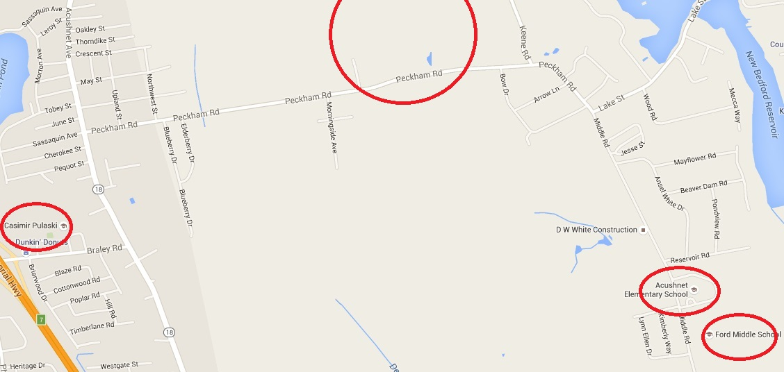
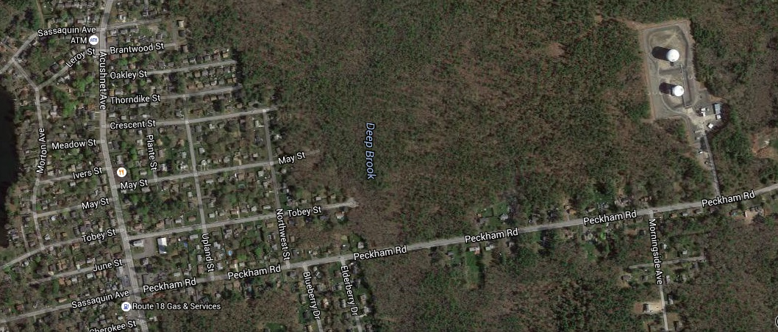
Notes:
Project will clear 200 acres of the 250 acre site, containing 40% wetlands, surrounded by homes, 2 schools within a mile

Slide 8
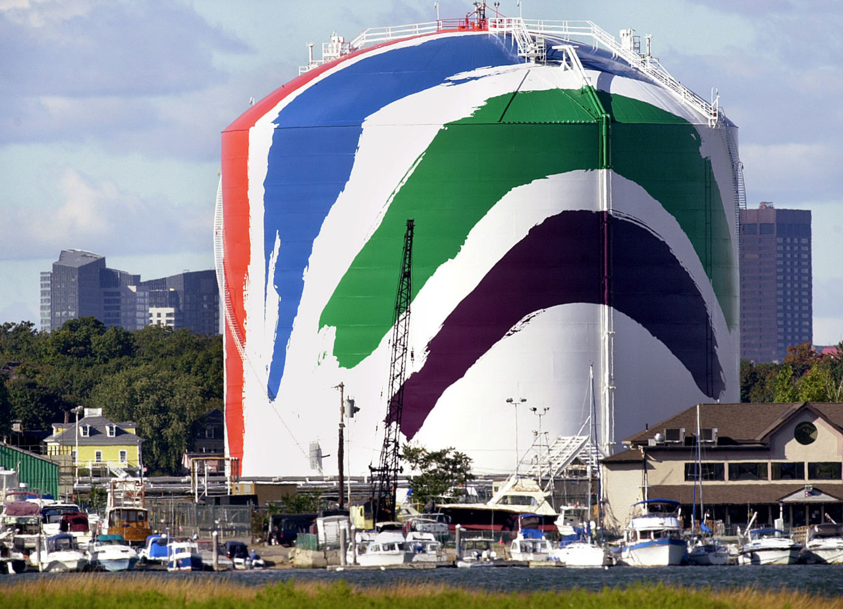
Notes:
Proposed tanks would be 6X bigger than Boston tank, 2X bigger than Everett tanks, bigger than what was proposed in Fall River

Slide 9
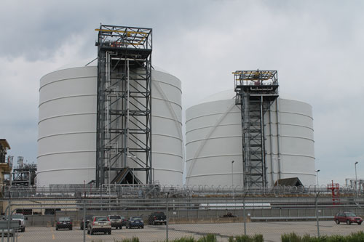
Tanks in Everett, MA
Notes:
Proposed tanks would be 2X bigger than Everett tanks, which hold up to 3.4 bcf

Slide 10
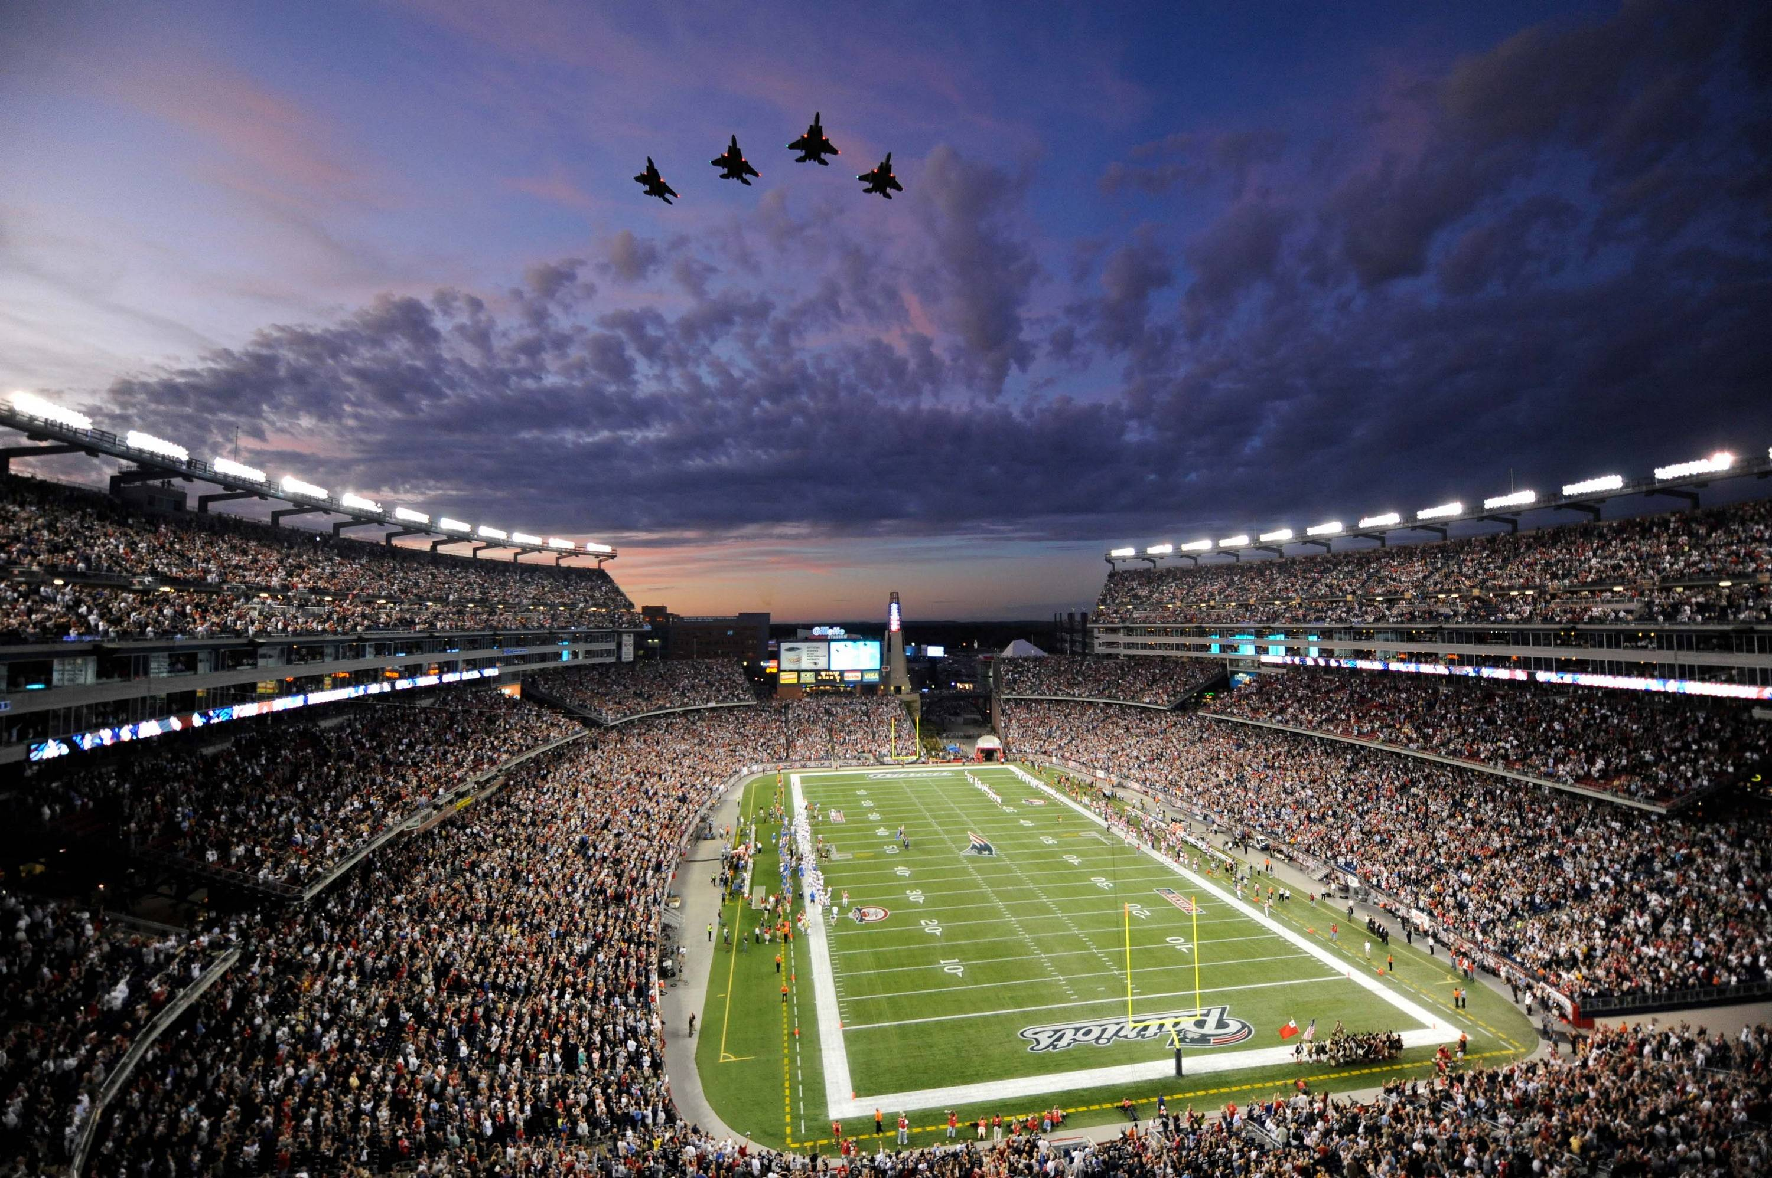
Notes:
Comparison to Gillette Stadium – 16 stories high, tanks will be 17. Area of stadium-34.6 acres, 250 will be used for this project. Each tank will be 90 yards across-about the size of a football field…= 2 Gillette Stadiums

Slide 11
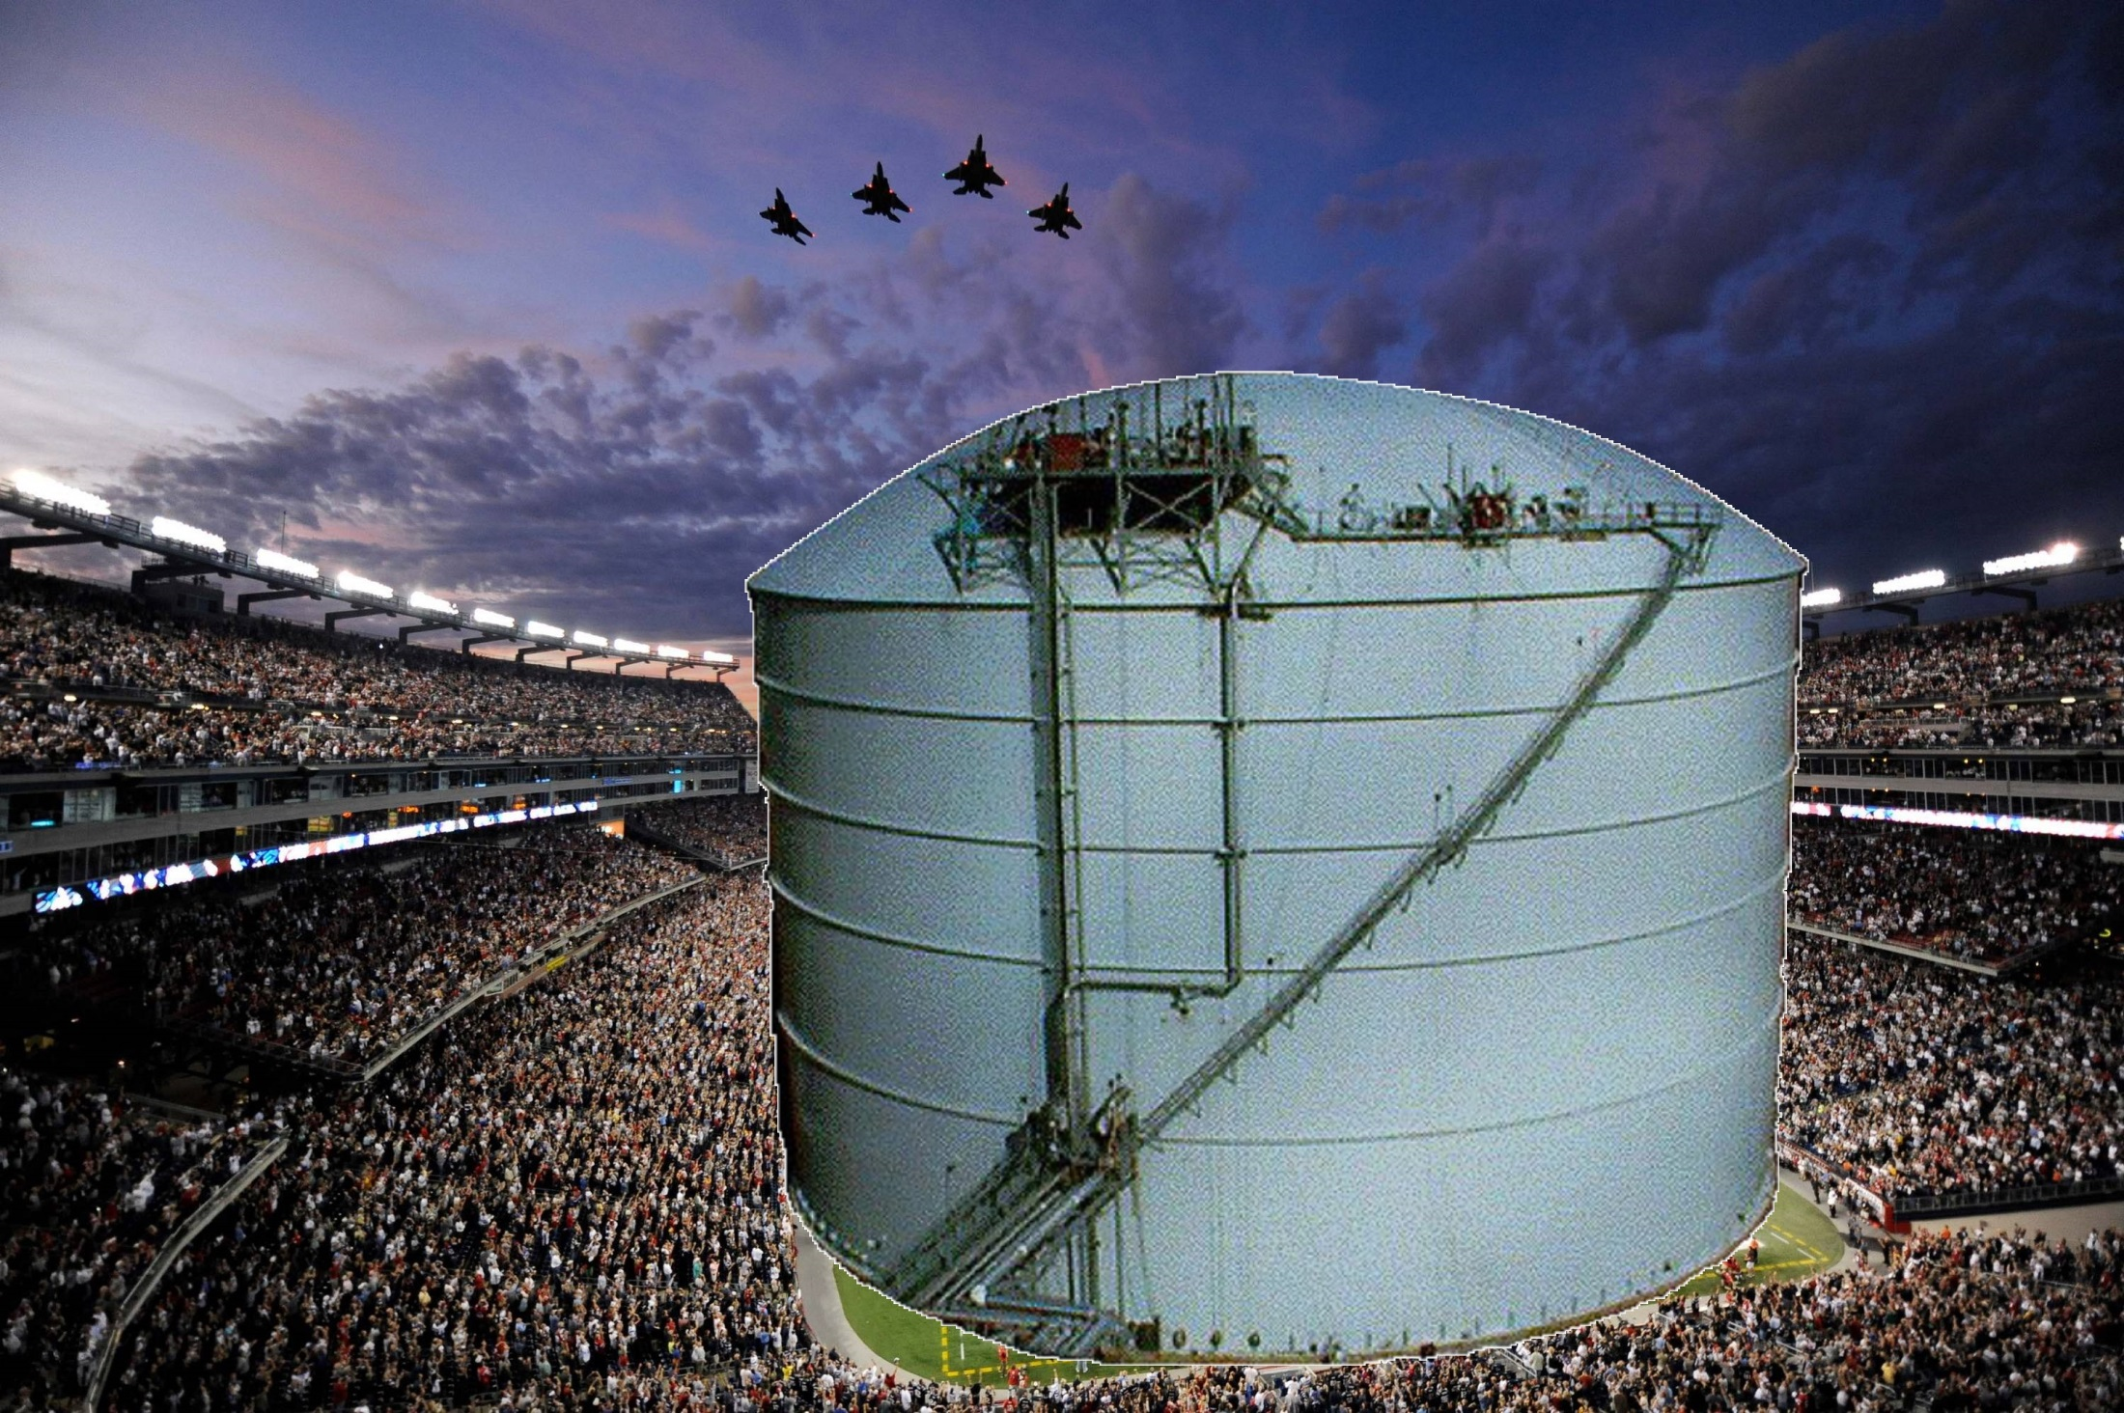
X2!

Slide 12
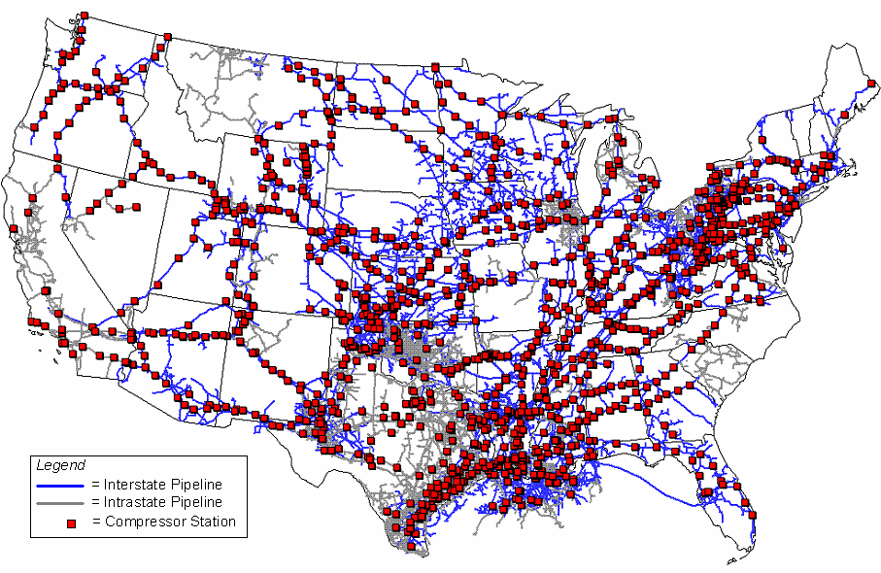
Notes:
Current pipelines in country/state

Slide 13
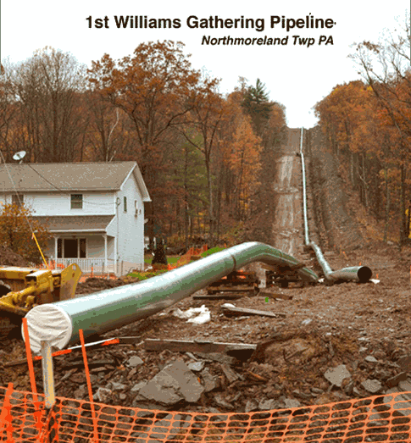
Notes:
Picture of pipeline in neighborhood, compare size of pipes & tanks to houses

Slide 14
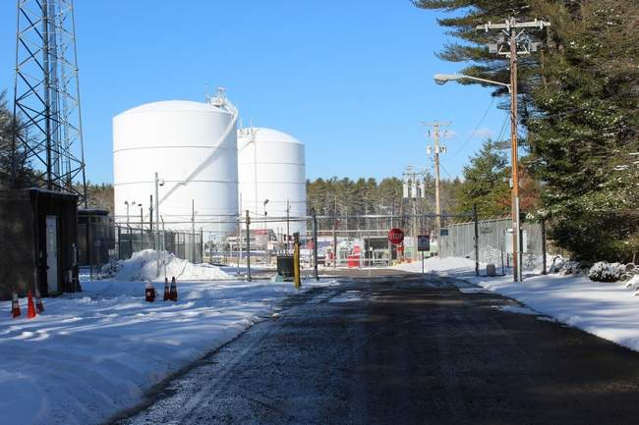
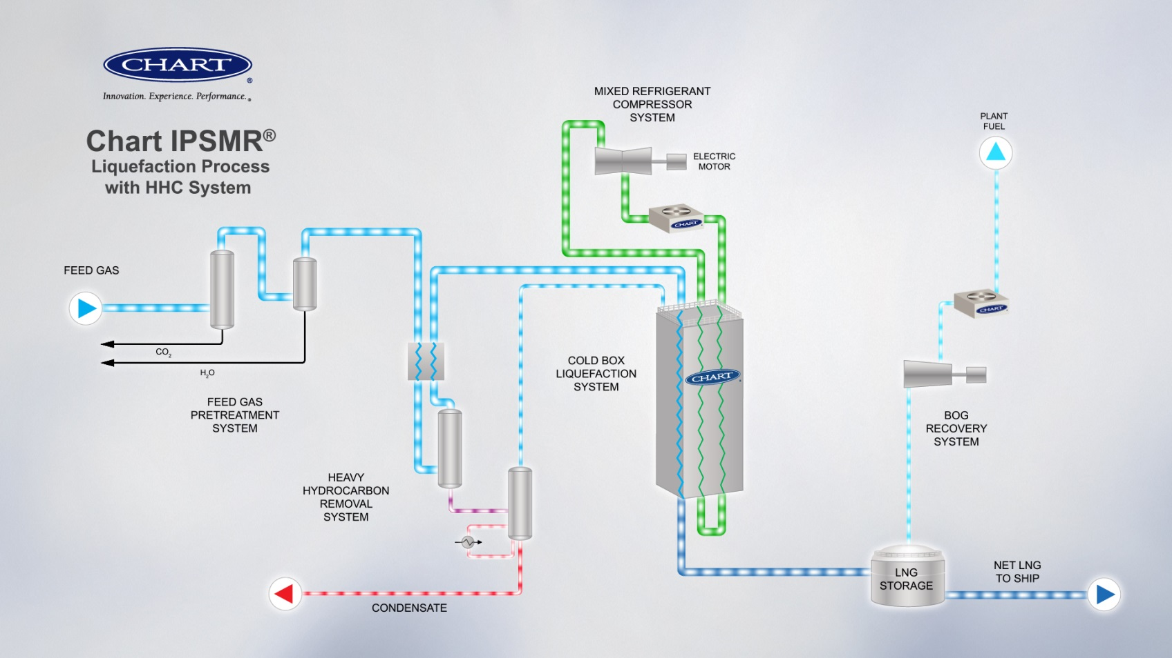
Notes:
LNG facility will not be just storage, will be production

Slide 15
Courtesy of Pipeline Safety Trust

Slide 16
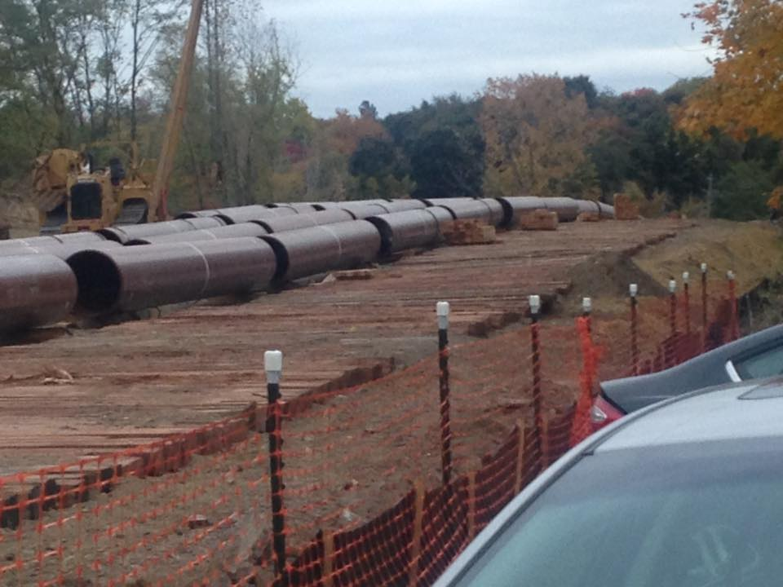
Construction ROW in Verplanck, NY – taken Dec. 2015
Notes:
24” pipes, through people’s yards – 650 psi

Slide 17
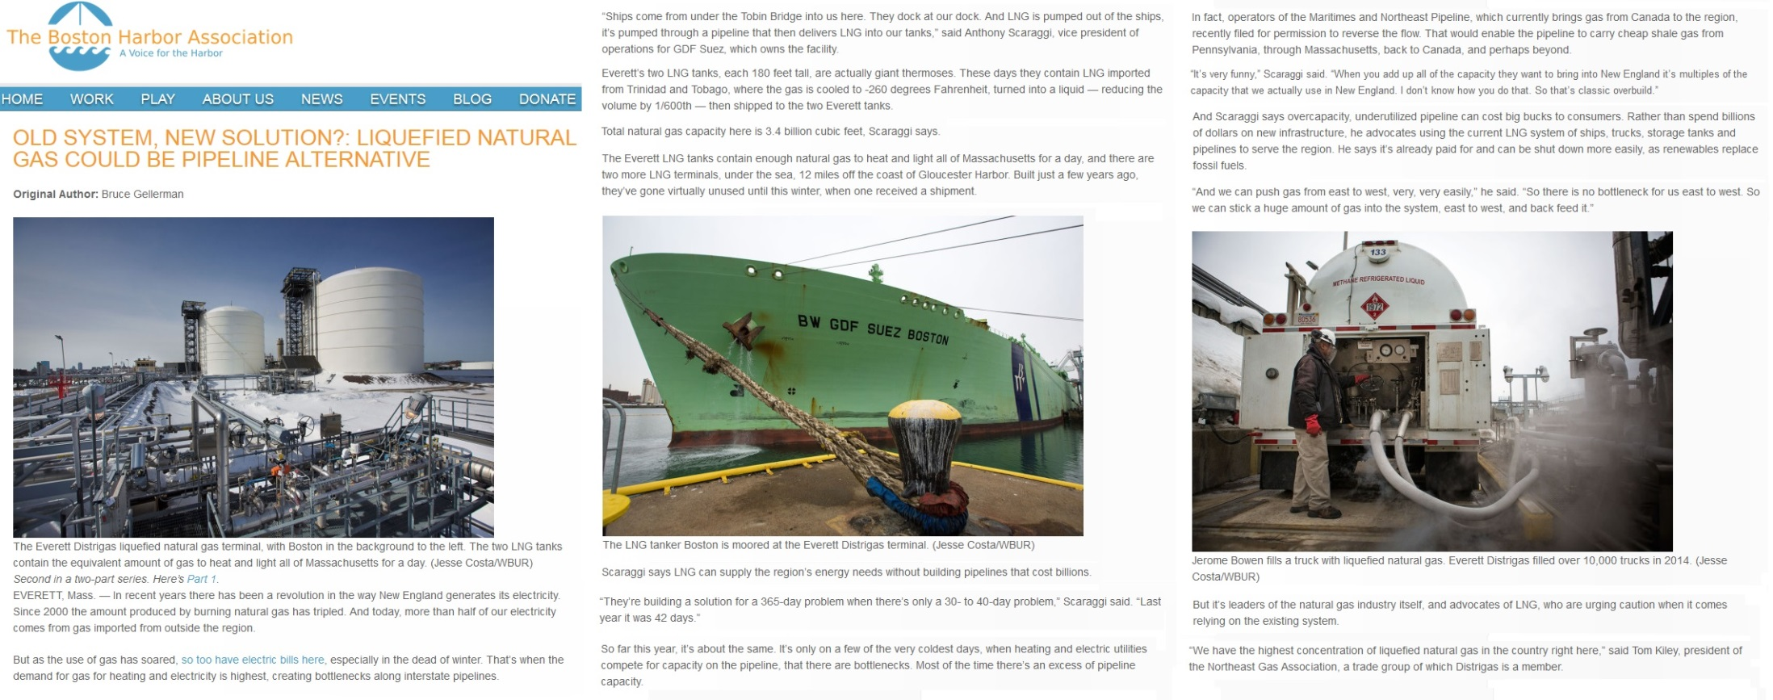
“They’re building a solution for a 365-day problem when there’s only a 30- to 40-day problem,” Scaraggi said. “Last year it was 42 days.”
“It’s very funny,” Scaraggi said. “When you add up all of the capacity they want to bring into New England it’s multiples of the capacity that we actually use in New England. I don’t know how you do that. So that’s classic overbuild.”
Notes:
Claim it’s needed for 0-45 coldest “peak” days of winter when gas demand is strong due to home heating needs & electric generation plants.

Slide 18
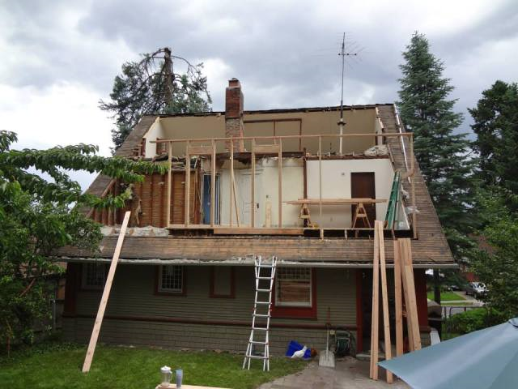
Getting ready for Christmas dinner…
Notes:
Would be like putting and addition on your house because you will have guests visiting at Christmas. Doesn’t make sense.

Slide 19
3 Recent Reports
Solving New England's Gas Deliverability Problem Using LNG storage and Market incentives
by Skipping Stone Consultants September 2015
Analysis of Alternative Winter Reliability Solutions for New England Energy Markets
by Energyzt Advisors, LLC August 2015
Power System Reliability in New England – Meeting Electric Resource Needs in an Era of Growing Dependence on Natural Gas
by Analysis Group November 2015
Notes:
3 Studies that have proven this is NOT necessary - sources

Slide 20
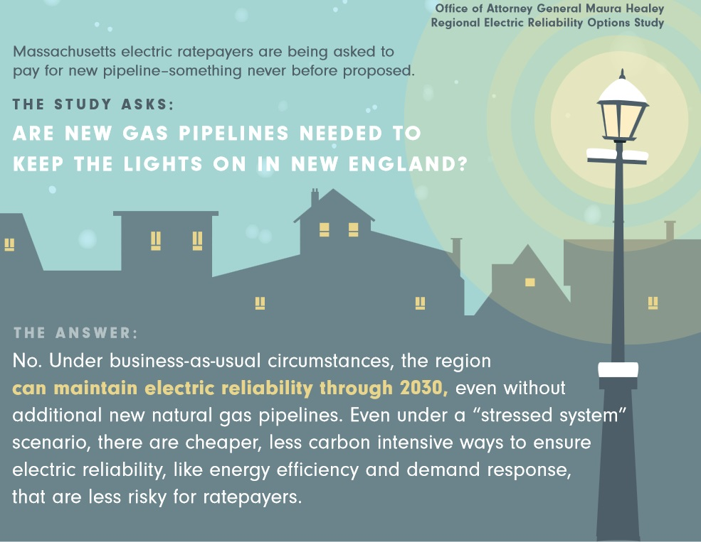
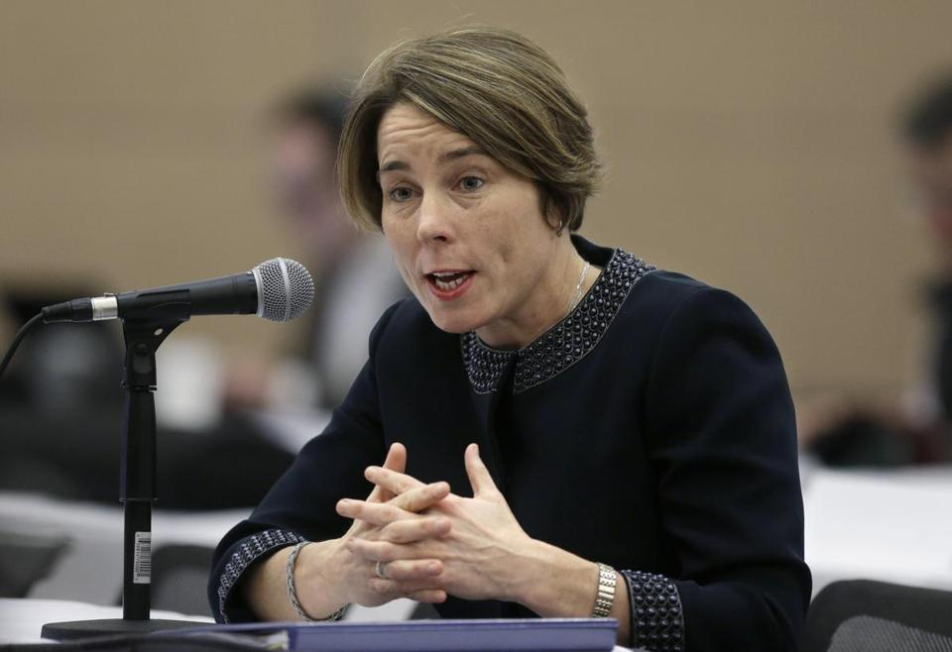
“This study demonstrates that we do not need increased gas capacity to meet electric reliability needs, and that electric rate-payers shouldn’t foot the bill for additional pipelines.” “Rate-payers will be subsidizing pipelines that won’t help them.”
Notes:
Attorney General – “This study demonstrates that we do not need increased gas capacity to meet electric reliability needs, and that electric ratepayers shouldn’t foot the bill for additional pipelines”. “Rate payers will be subsidizing pipelines that won’t help them.”

Slide 21
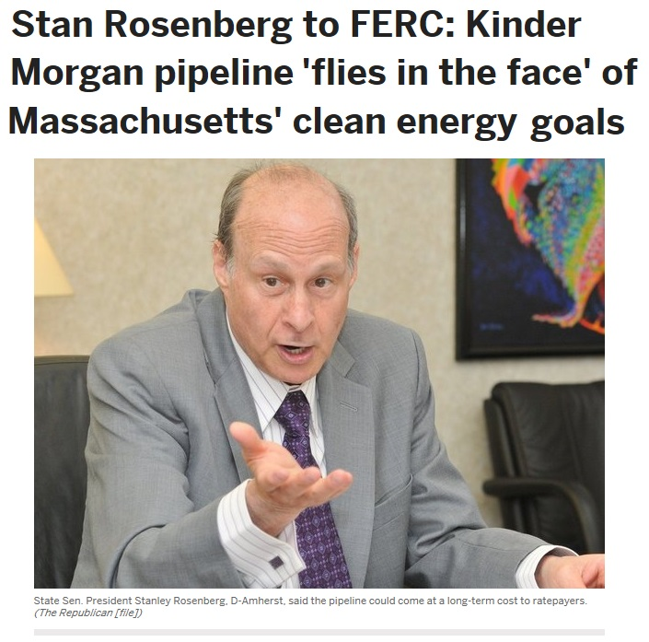
Notes:
Senate President Stan Rosenberg “Kinder Morgan pipeline “flies in the face” of Massachusetts clean energy goals.” We have a plan for our energy future and more natural gas is not that plan.

Slide 22
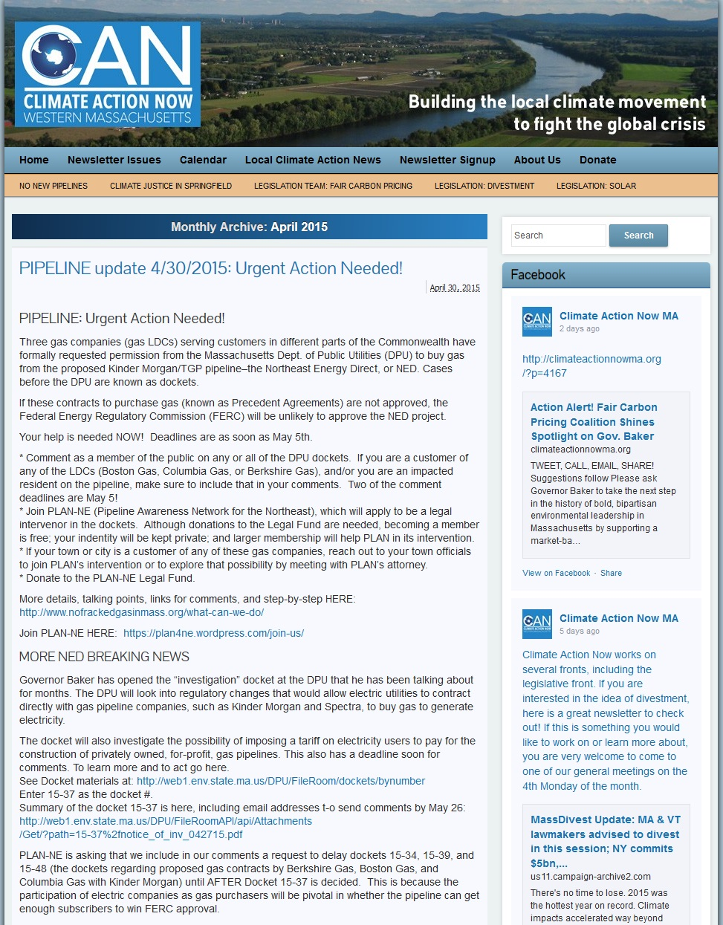
Notes:
http://climateactionnowma.org/?m=201504

Slide 23
Notes:
US production of natural gas is due to fracking…

Slide 24
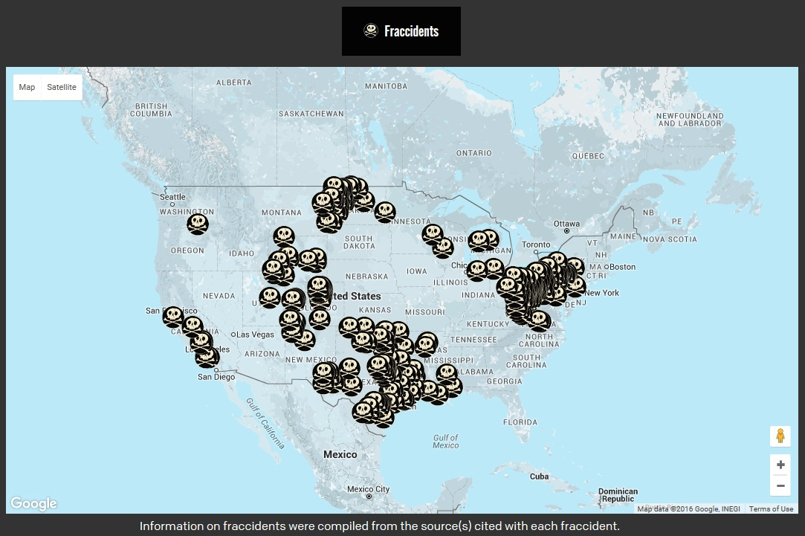

Slide 25
Notes:
exporting

Slide 26
Notes:
Gas leaks in MA – report prepared for Se. Ed Markey – MA Ratepayers paid between $640MM-$1.5B from 2000-2011 for gas that never reached their homes.
http://www.clf.org/wp-content/uploads/2013/08/Markey-Gas-Leaks-Report-2.pdf

Slide 27
MA Rate-payers paid between $640MM - $1.5B from 2000-2011 for gas that never reached their homes.
Current regulations allow the gas companies to pass those costs on to the Rate-payer.
No incentive to repair the leaking pipes.
At LEAST 99 billion cubic feet of natural gas was “lost and accounted for”.
Acushnet tanks would hold 6.8 bcf of LNG.

Slide 28
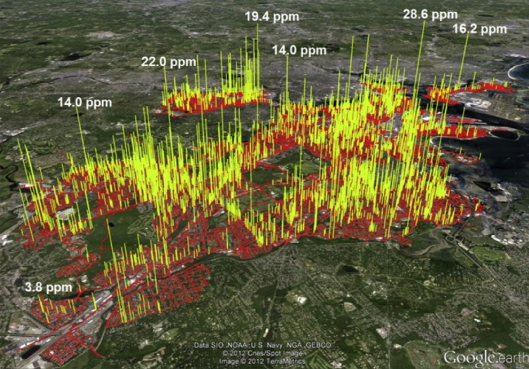
BU Professor Nathan Phillips and Bob Ackley of Gas Safety drove a high precision GIS-enabled natural gas analyzer down the roads around the gas leak to create these images. The red shows where they drove in summer of 2012 and the levels of methane they found is shown by the height of the peaks.
Notes:
Gas companies replace less than 4% of their leak prone pipes per year. At least 99 billion cubic feet of natural gas was lost & unaccounted for. Acushnet tanks would hold 6.8 bcf of LNG. http://www.bu.edu/today/2012/boston-street-level-gas-leaks-3300-plus/?utm_source=social&utm_medium=facebook&utm_campaign=prbumain&sf7817599=1

Slide 29
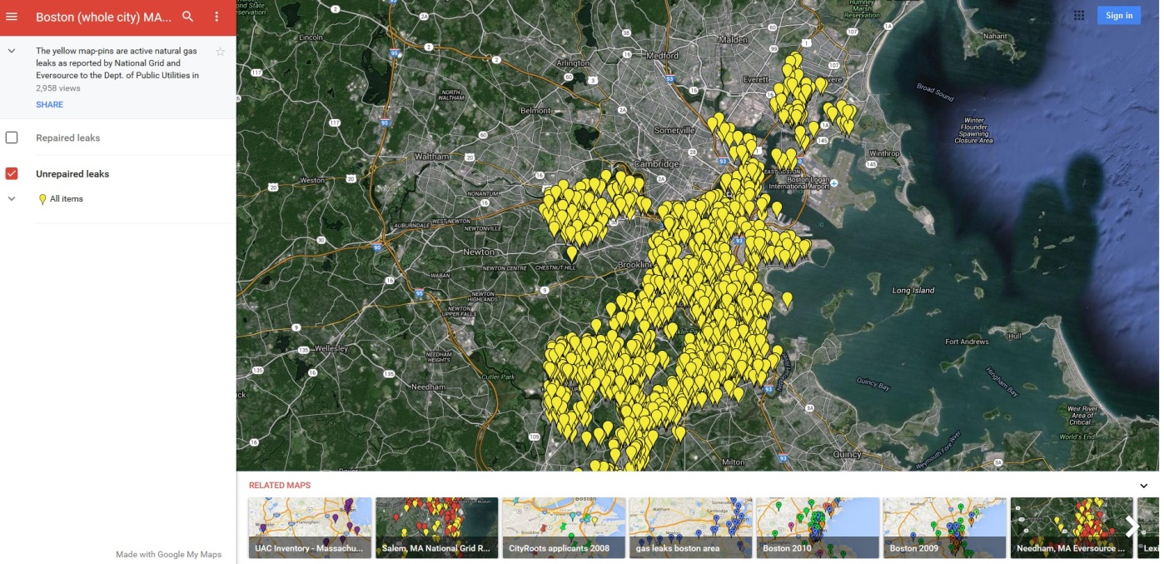
Gas leaks just in Boston alone per www.heetma.org
Notes:
Leaky pipes are causing green house gases/methane released into atmosphere. 20,000 identified gas leaks in MA. HEET

Slide 30
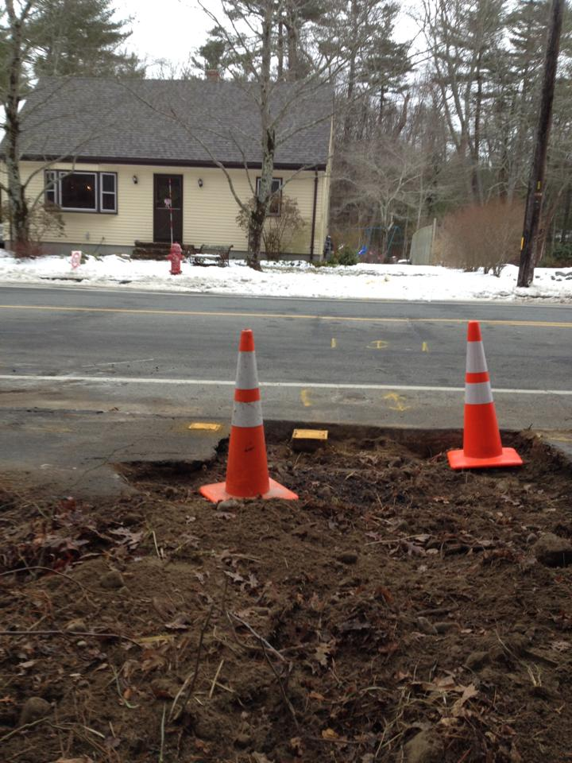
Notes:
Ongoing problem with a gas leak at Morningside Road in Acushnet in front of the existing LNG facility.

Slide 31
Rhode Island Atty Gen'l Releases Report on "LNG Facilities in Urban Areas: Security Risk Mgt. Analysis." Principal Investigator: Richard A. Clarke (May 17, 2005) -- The Rhode Island Attorney General's office has released a detailed, at times chilling, 150+ page report entitled "LNG Facilities in Urban Areas: A Security Risk Management Analysis."
The report's principal investigator was Richard A. Clarke, former National Security Council counter-terrorism advisor on 9/11/01...whose book (Against All Enemies) and 9/11 Commission testimony criticized former administrations and charged the Bush administration failed to take adequate protective measures in the elevated-threat period preceding the 9/11 attacks.
In a written release, Rhode Island Attorney General Patrick Lynch said:
"This is the kind of information that the big-money LNG industry hasn’t wanted the public to have since they started putting all of these terminal proposals on the drawing board. I hope that Richard Clarke’s threat analysis helps inform the public, both here in Southeastern New England and nationally, about the stupidity and short-sightedness of siting LNG facilities in densely populated urban areas."
Clarke presented the report to RI Attorney General Lynch on May 9 at Brown University. The report states in part:
"If all alternative sites do cost more and governments do proceed with the proposed urban location because of that cost differential, then the cost trade-off can be precisely measured. Governments would be deciding that avoiding the possible additional financial cost to the LNG operator and/or consumers of a more secure location is more important public policy than avoiding the additional risk of a catastrophic attack involving mass trauma and burn injuries which does accompany a decision to permit an urban LNG facility.“
In his testimony before FERC, he stated, “I can think of few actions that our government could take that would be as prejudicial to the public. An urban LNG facility would rank high on any terrorist’s list of target opportunities.”

Slide 32
Notes:
Gas leak in CA – began October 23rd, declared state of emergency, may not be plugged until end of March. “It’s the BP spill on land,” said Environmental law activist Erin Brockovich. Residents in nearly 2,290 households have been displaced. Not LNG, but the residents in that area were most likely told that the facility in their neighborhood would be safe too.

Slide 33
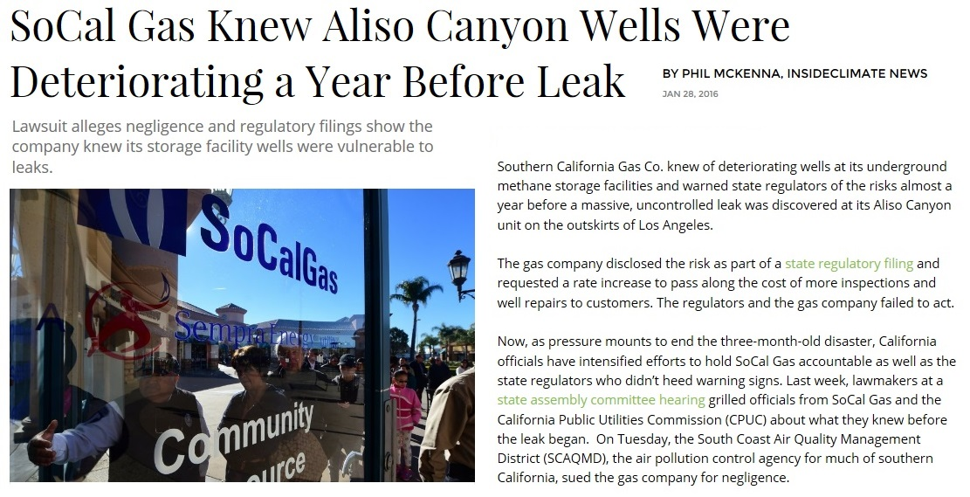

Slide 34
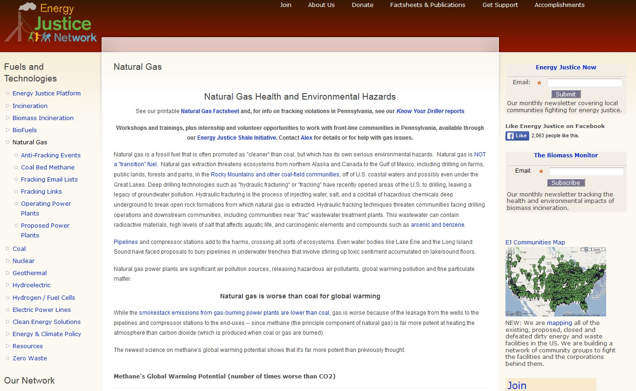
Notes:
Health issues

Slide 35
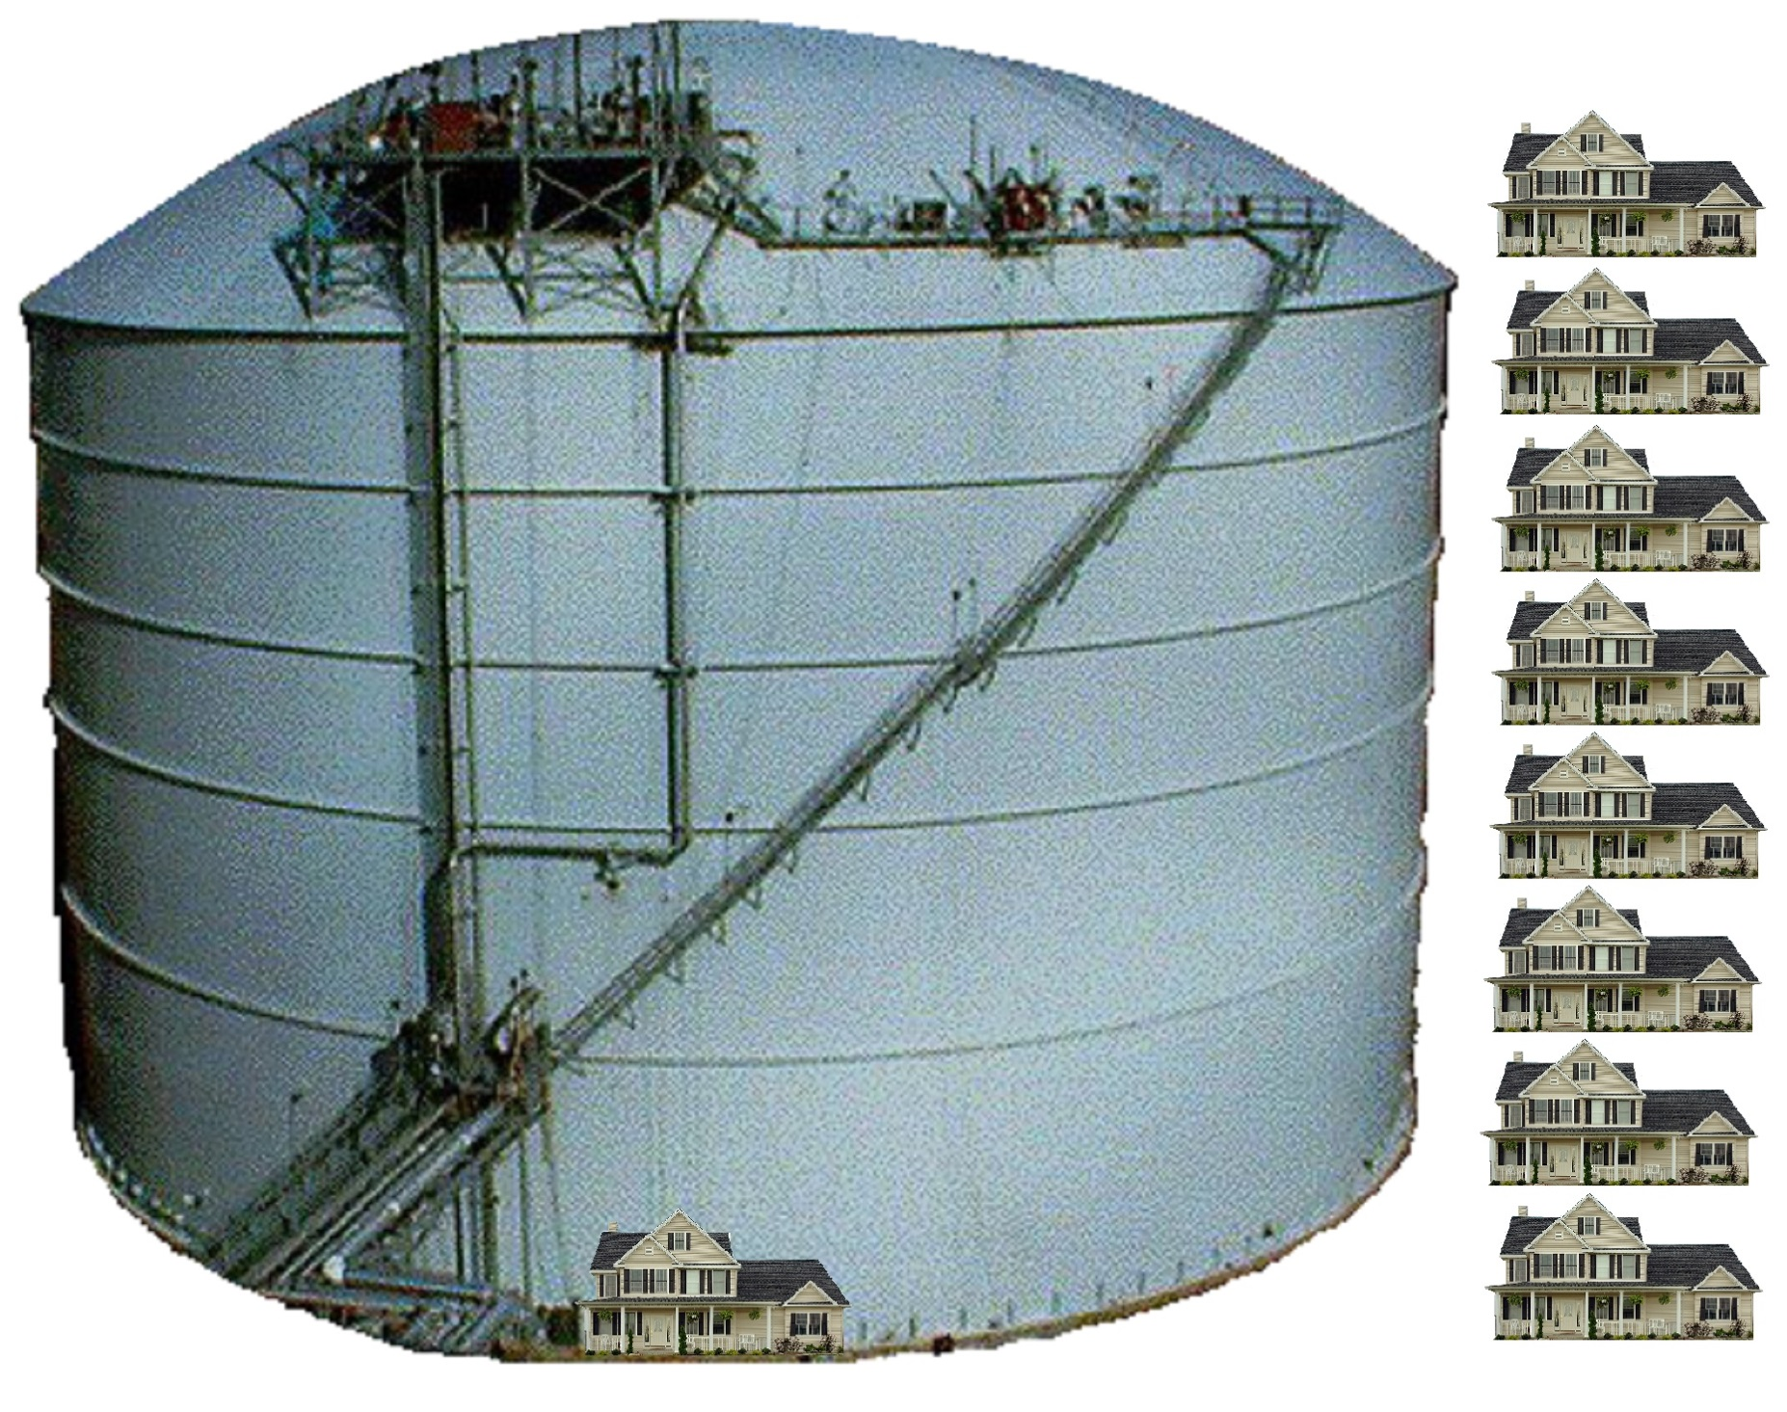
What’s more important to this community?
Notes:
What can Acushnet do? Hire a Consultant & conduct independent studies. Eversource does not have OUR best interests in mind & if Acushnet does, then they will do their due diligence to protect their residents AND community.

Slide 36
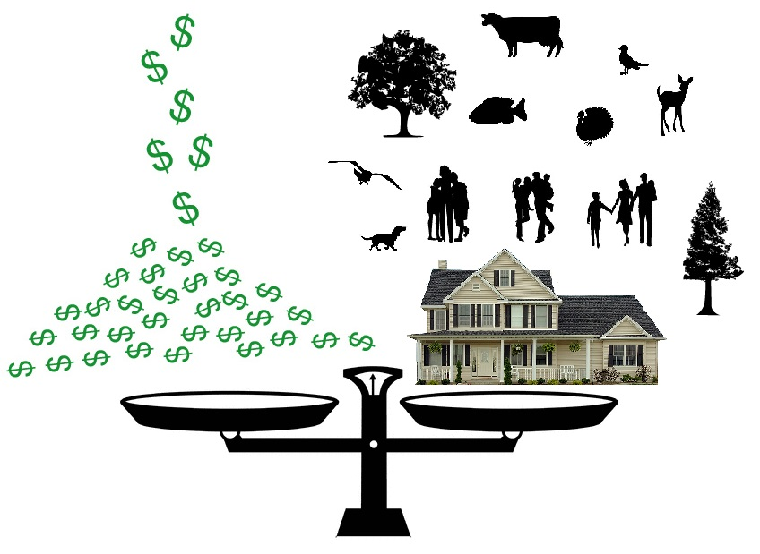
What should be the most important priorities in our community?
Notes:
$ is the only possible reason to do this to our community. If it is about the $, then that is being put a head of the safety and health of the citizens in this community.

