Slide 1
Access Northeast: Meeting New England’s Energy Needs
Acushnet Board of Selectmen
March 14, 2016

Slide 2
Project Developers:

Slide 3
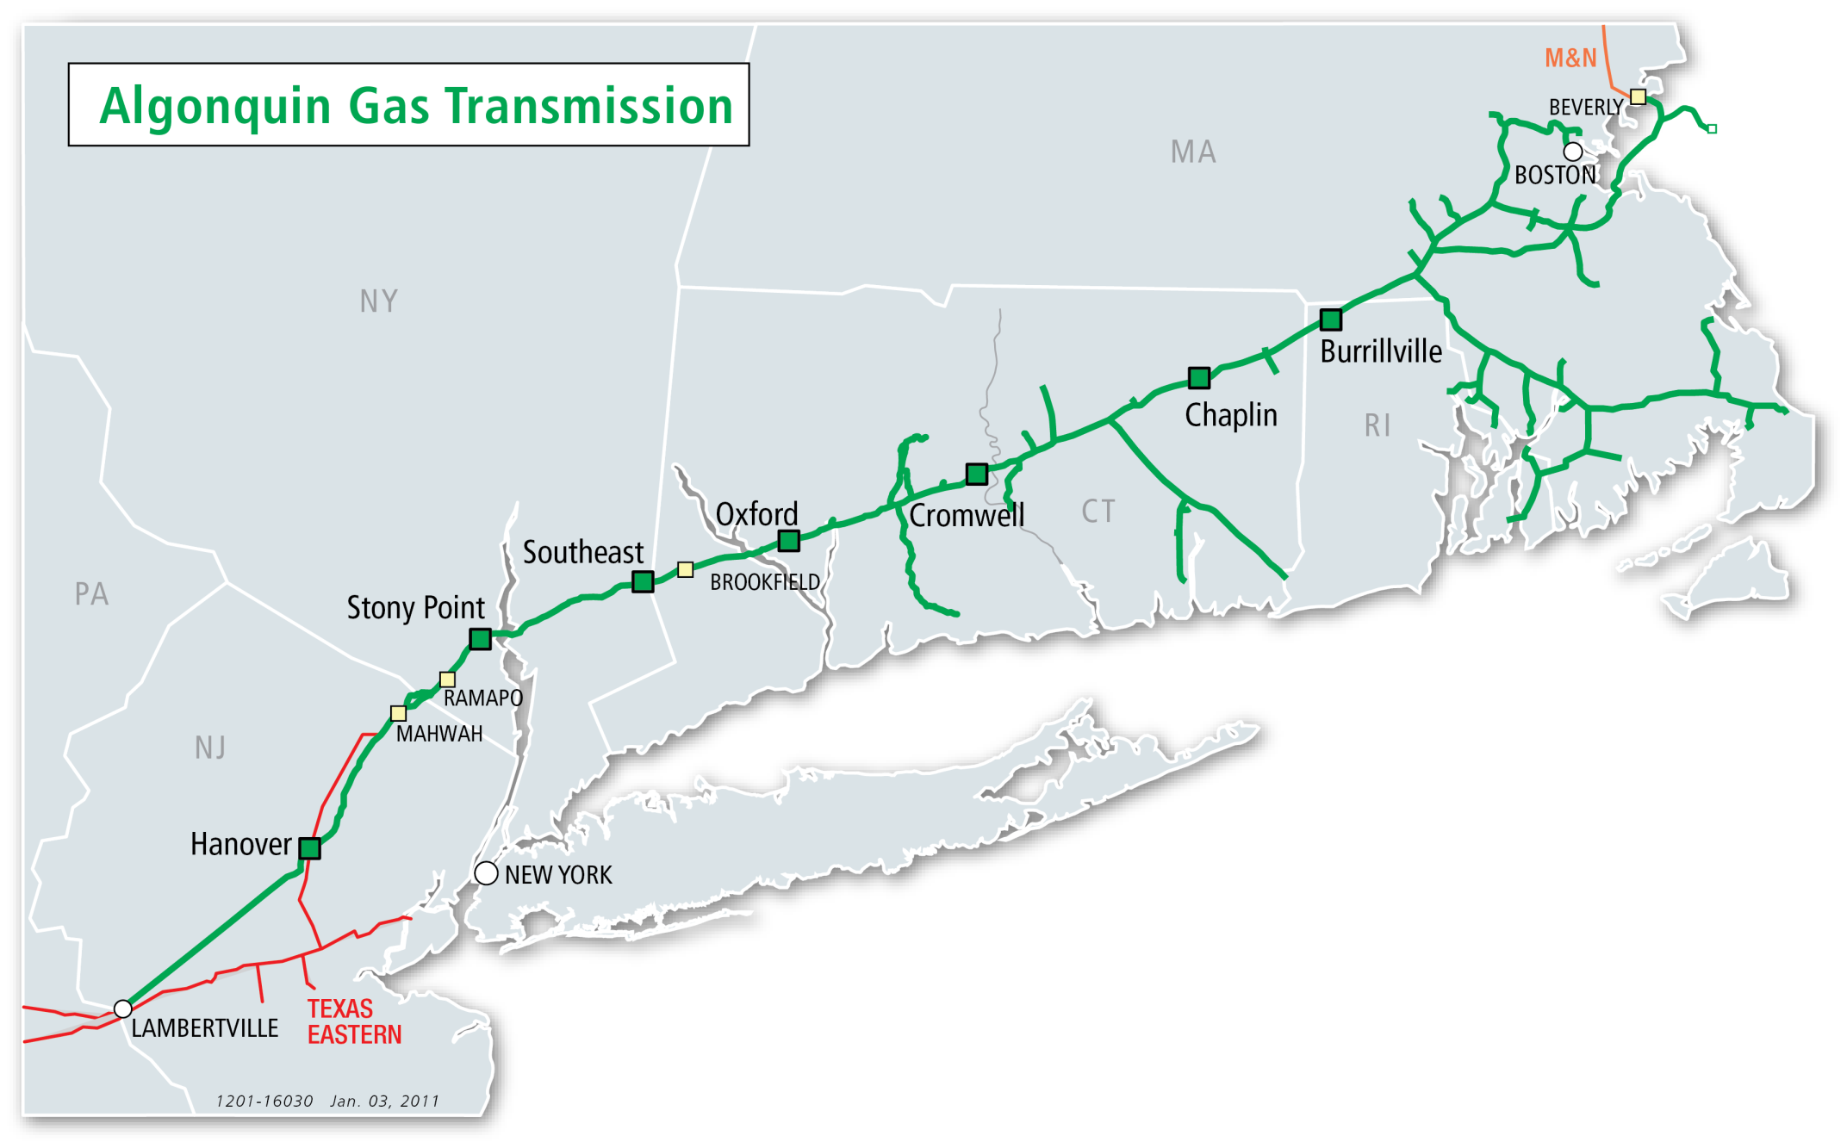
Algonquin Gas Transmission
Approximately 1,127 miles of pipeline facilities in the Northeast
Transports up to 2.63 billion cubic feet per day of natural gas
First delivery to New Bedford Gas & Electric on September 9, 1953.
Operating safely for more than 60 years
Regulated by FERC and US DOT

Slide 4
The Challenge: Lack of Energy Infrastructure in New England
New England has the highest electric prices in the continental United States per the U.S. Energy Information Administration
New England’s Independent System Operator (ISO-NE) recently stated in its 2016 “State of the Grid” presentation: “The price of wholesale power in New England is directly correlated to the price of natural gas. When electric generators can’t get natural gas, prices spike.”
Sustained high energy prices limit economic growth and competiveness
Electric reliability is threatened during peak energy demand times
Residential customers feel the impact of a lack of pipeline infrastructure through higher utility bills
Access Northeast is the only proposed project focused on electric reliability

Slide 5
These Costs Burden the New England Economy
Change in Average Residential Electricity Prices
First half 2014 vs First half 2013
Gap widened further in 2015
New England customers saw 25% - 100% jump in power supply costs
(source: EIA)

Slide 6
Recognizing the Problem
ISO-NE reaffirmed in its 2016 “State of the Grid” presentation that: “New England needs additional energy infrastructure, including natural gas infrastructure, to meet growing demand for natural gas for both heating and power generation.”
The Attorney General’s study identifies 4,900 MW reliability gap by 2030
In its base case analysis, study estimates that 2,400 MW of gap will be filled by gas-fired power plants converting to dual fuel capability
In its stressed system scenario, study estimates that 4,900 MW of aggregate new dual fuel capability is required to ensure winter reliability
The Connecticut DEEP recently stated that there is inadequate pipeline delivery capacity into and within New England to meet gas-fired generation requirements, which has the potential to threaten grid reliability, especially during cold winter weather.

Slide 7
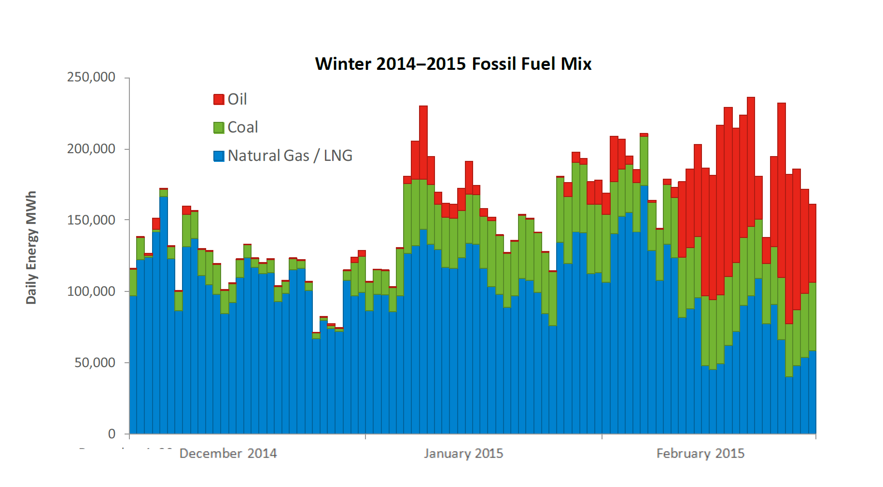
New England Shifts to Coal and Oil in the Winter
*ISO-NE, Gordan van Welie presentation, November 2015

Slide 8
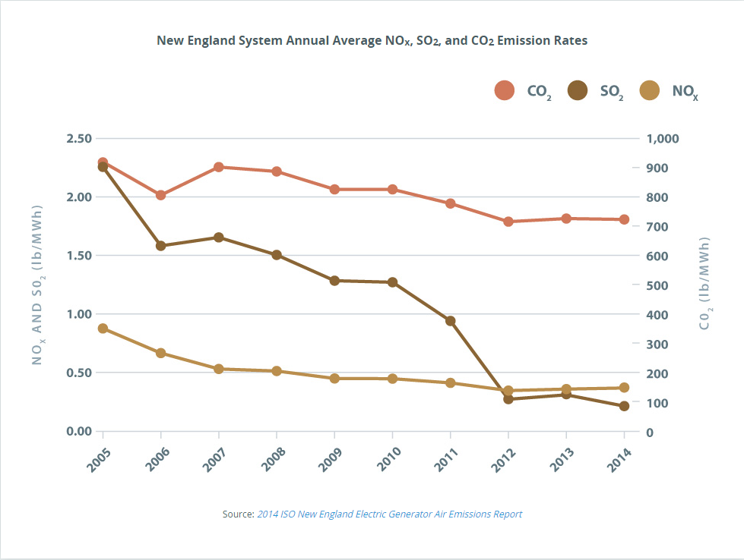
Reductions - Greenhouse Gas Emissions
New England’s Independent System Operator (ISO-NE) recently stated in its Regional Air Emissions Report that the “ongoing trend to meet electricity needs with higher-efficiency, lower-emitting gas-fired generators instead of oil- and coal-fired generators has been the biggest contributor to the long-term decline in regional emissions.”
The accompanying news release said, “Looking at year-over-year changes, there has been a slowdown in emissions reductions with the key contributor being increased generation from high-emitting units (coal, oil) when natural gas pipelines are constrained.”
And, “emissions increases or slowdown in declines…largely reflect winter-time constraints on the interstate pipelines,” which operate at or near full capacity to serve heating demand during most of the winter

Slide 9
Access Northeast Project
Approximately 15 percent of New England’s electric generating capacity has announced plans to retire within five years.
Recent and pending coal, oil and nuclear-powered generators retirements (including the Pilgrim Nuclear Power Station) will total nearly 4,200 MW between 2014 and 2019
Access Northeast is designed to maximize direct pipeline interconnects to power generators and advance a customized solution to New England’s energy challenge.
Innovative, cost effective & environmentally responsible approach
More than 95% of the solution will utilize existing pipeline, utility corridors, roadway corridors and natural gas infrastructure, thus minimizing environmental and community effects
It will help stabilize electricity rates and will save the region billions of dollars in energy costs
Access Northeast is timely - it could begin service as early as 2018
Access Northeast size and scope is aligned with ISO-NE State of the Grid

Slide 10
Access Northeast ‐ Purpose and Need
Will provide 0.9 Bcf /day of natural gas to power plants by:
Upgrading existing Algonquin Pipeline
Add regional LNG storage
Will increase access to plentiful natural gas supplies
Ensuring energy security
Lowering electric costs
Reducing carbon emissions
Provides rapid response capability - a first of its kind service to electric generators that will:
Meet peak winter day needs
Back stop intermittent solar and wind renewable power
AGT and M&N systems directly connect to 60% of ISO-NE’s gas-fired generators
Will provide fuel for 5,000 MW of electric generation; or enough electricity to power over 5 million American homes
PORTLAND
Maritimes & Northeast
BOSTON
Algonquin Gas Transmission
NEW YORK
AGT and M&N systems directly connect to 9600 MW of ISO-NE gas fired power generation
New gas-fired generators totaling ~2750 MW attaching to AGT by 2019
Texas Eastern

Slide 11
Proposed Massachusetts Facilities
Massachusetts Facilities:
LNG storage facility at existing Eversource site - Acushnet.
Acushnet Pipeline: ≈ 3 miles of 24-inch diameter pipe in Freetown and Acushnet to existing Eversource property used for LNG storage facility.
Q-1 Expansion: ≈ 21 miles of 30-inch pipe looping existing AGT pipeline easement in Medway, Bellingham, Franklin, Millis, Norfolk, Walpole, Sharon, Stoughton & Canton.
West Boylston Lateral: ≈ 27 miles of 16-inch pipe along existing National Grid corridors, in Medway, Milford, Upton, Grafton, Sutton, Millbury, Shrewsbury, Boylston & West Boylston.
Weymouth Lateral: ≈ 4 miles of 30-inch pipe along existing Route 3 & Eversource corridors in Braintree & Weymouth.
Weymouth: ≈ 10,900 HP of compression to be added to Atlantic Bridge compressor station.
A new compressor station - Rehoboth.

Slide 12
Proposed Timeline
Deliverables | Target Dates
Initial Outreach (Government Officials, Agencies, Landowners, other Stakeholders) | June/July 2015
Informational Meetings | August/October 2015
Initiated FERC Pre-filing (Docket No. PF16-1-000) | November 17, 2015
Open Houses | January 2016
FERC Scoping Meetings | April 2016
File FERC Application and other permit applications | Q4 2016
FERC Certificate Issuance | Q1 2018
Initiate Construction | Q2 2018
Initial Phased In-Service Date | Q4 2018

Slide 13
Environmental Permits and Approvals
Federal
FERC: EIS and Certificate of Public Convenience and Necessity
Army Corps of Engineers: Sections 10/404 Individual Permit
EPA, NOAA, FWS, SHPOs, THPOs: Consultation
Massachusetts
EOEEA – MEPA EIR – MCZM
MassDEP - 401 WQC, Air Plans Approvals, Waterways License, SOCs
Energy Facilities Siting Board – Consultation/Participation in FERC Process
Mass. Historical Commission - NHPA Section 106 Review
NHESP - Review and CMPs
Local Conservation Commissions – Wetlands Protection Act

Slide 14
Pipeline Safety – Layers of Safety
Design Phase
Optimize routing
Utilize pipe manufactured from high strength alloyed steel
Construction Phase
100% of welds ultrasonically or X-ray inspected – exceed regulations
Pipe and welds are sealed with protective coatings
Test pipeline prior to placing in-service
Operational Safety
Gas Control (24/7/365)
Above and Below Ground Coating Maintenance
Cathodic Protection
Integrity Management Program
Ground & Leak Surveys
Aerial Patrols
Valve Maintenance
One-Call

Slide 15
Construction & Restoration Photo Examples

Slide 16
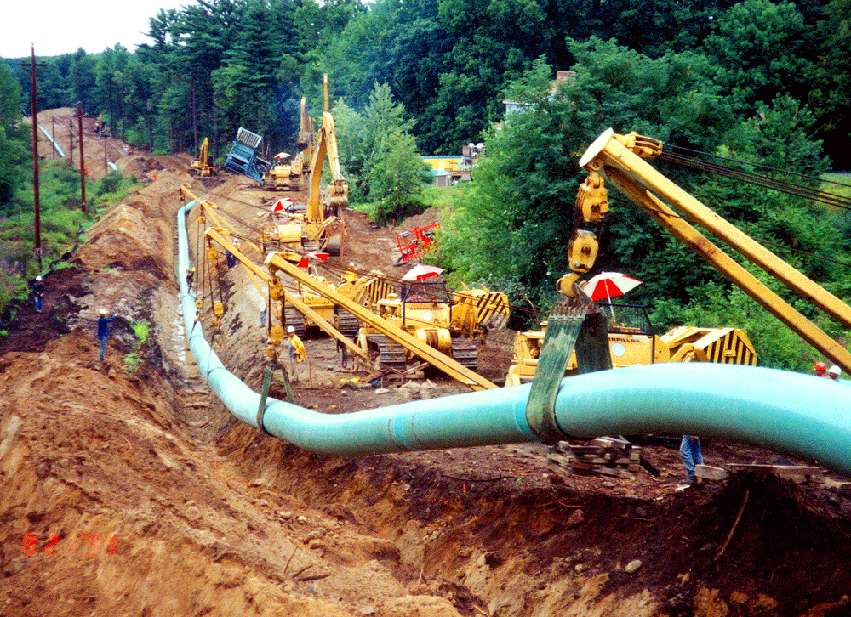
Side Booms
Lowering-In

Slide 17
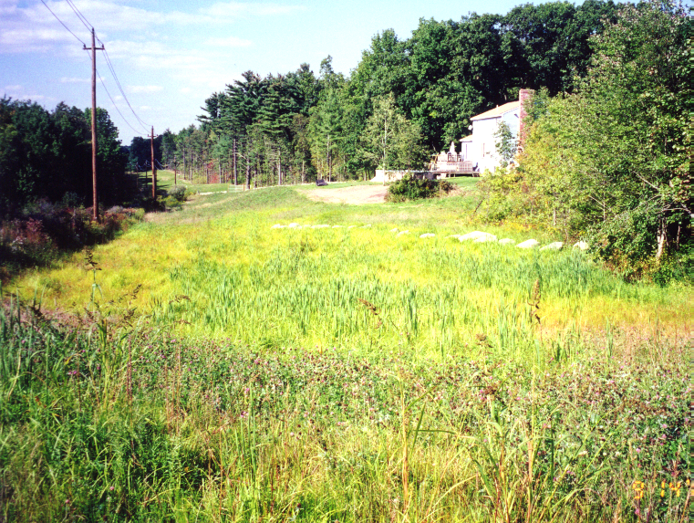
Restoration Progress - One Year After Construction
During Construction

Slide 18
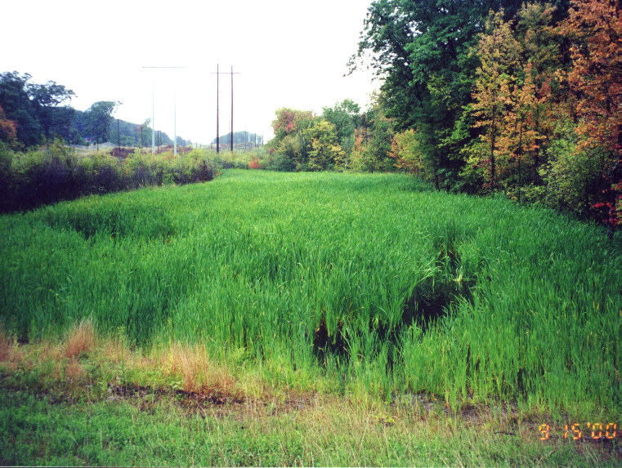
Restoration Progress - One Year After Construction
Joint Facilities Pipeline Project, MA

Slide 19
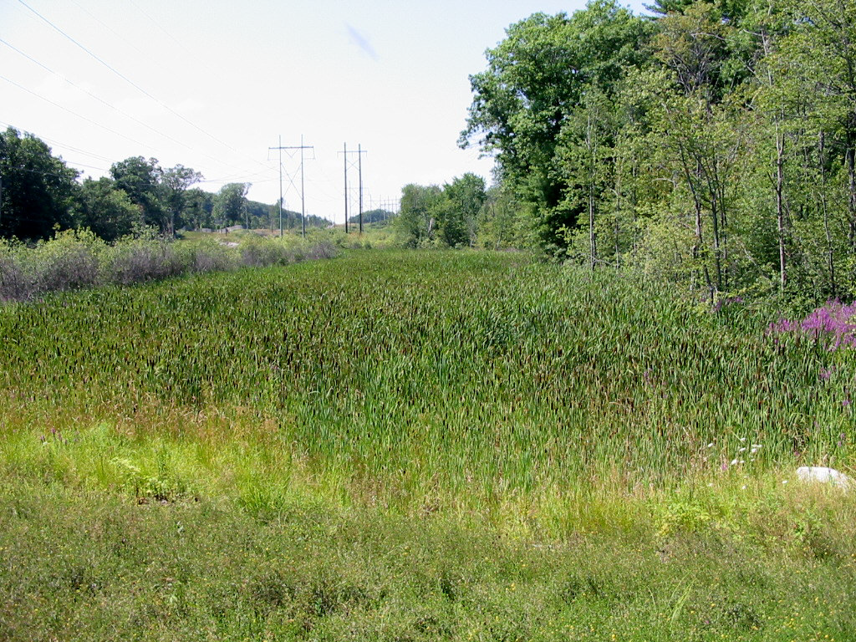
Restoration Progress - Two Years After Construction
Joint Facilities Pipeline Project, MA

Slide 20
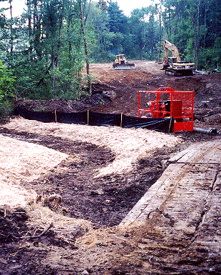
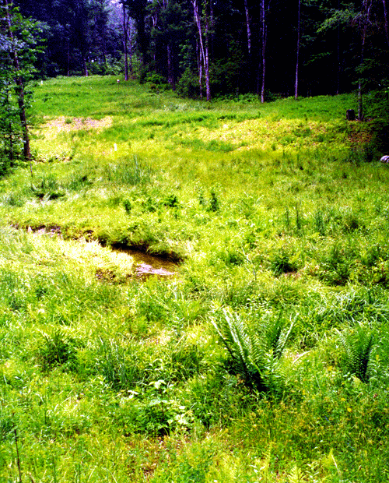
DURING
AFTER
Fishin Brook – Haverhill

Slide 21
LNG Facility Safety – Layers of Safety
Federal Agencies: Siting, Design, and Review Requirements
DOT PHMSA requirements (49 CFR Part 193 / NFPA 59A)
Thermal radiation and vapor dispersion exclusion zones, full hazard analysis
FERC design review for safety, reliability, and operability
Cryogenic design review process of entire facility design
Independent Layers of Protection for Safety
Structural Design Requirements (earthquake, winds, flooding)
Mechanical Design Requirements (material selection, pressure testing)
Operation and Maintenance Plans (operational procedures, testing requirements)
Control and Safety Systems (DCS controls, SIS systems, ESD systems)
Security Systems and Plans (monitoring, cameras, access controls, patrols)
Physical Protection Devices (relief valves, ignition controls)
Spill Containment Systems (trenches, basins, curbing, grating)
Hazard Detection Systems (fire detection, gas detection, alarms and shutdown)
Hazard Control Equipment (dry chemical systems, firewater systems)
Emergency Response Plans (coordination, response)

Slide 22
Gas System Enhancement Program - GSEP
Replacement of all aging steel and cast iron pipe over the next 25 years with plastic pipes which has a significantly lower leak rate and is more durable and resistant to cracking
Replacement rate will be 50 miles per year following the initial ramp-up period which began in 2015
In 2016 Eversource plans to replace 35 miles of leak prone main and 2700 associated services throughout its service territory at a cost of $52.7M
The accelerated pipe replacement program addresses and improves the safety of the system and environmental impacts by reducing methane emissions from the Eversource gas distribution system by more than 50,000 tons annually.
Assessing new leak detection technology to further enhance the safety of the system and impacts to the environment

Slide 24
Benefits of the Project
The Project lowers the region’s electricity costs by $1B annually
Jobs
2,100 construction jobs throughout the N.E. region for pipeline upgrades and LNG storage
Will utilize local labor when feasible
25+ new permanent jobs at Acushnet facility
Tax revenue for Acushnet
An estimated $10M - $12.5M on average/year for the first 20 years
An estimated $200M - $250M over 20 years

Slide 25
Access Northeast: Meeting New England’s Energy Needs

